Slide 1

Do we work better at home or at 1,5 meter?
Lode Godderis & Liesbeth Daenen
March 25, 2021

Slide 2
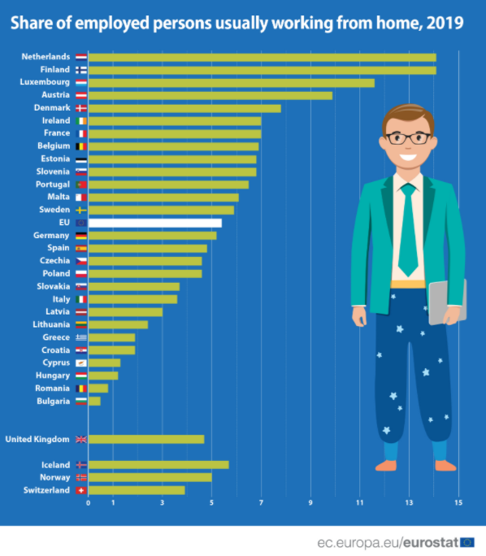
Telework in the European Union
www.ec.europe.eu, 2020

Slide 3
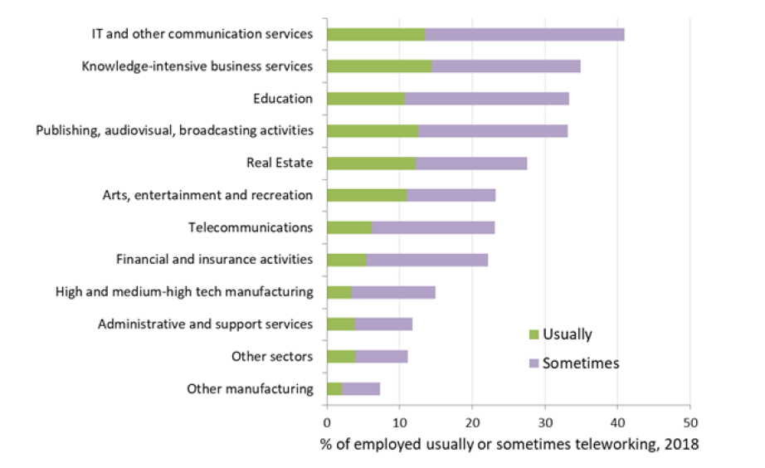
Prevalence of telework across sectors
EU-LFS data provided by Eurostat, 2018

Slide 4
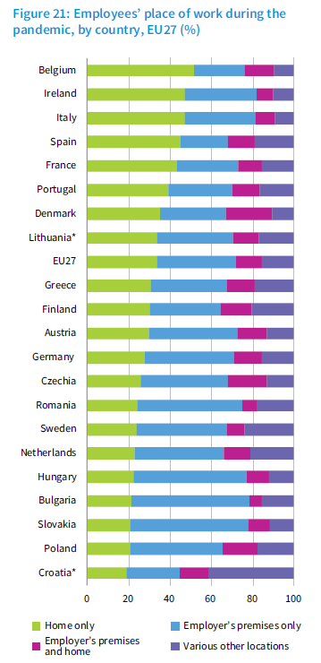
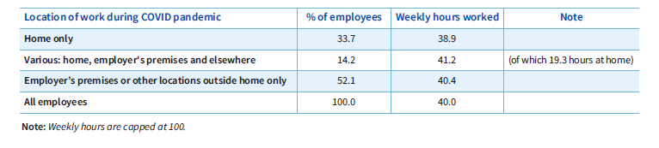
Telework during COVID-19 pandemic
www.ec.europe.eu, 2020

Slide 5
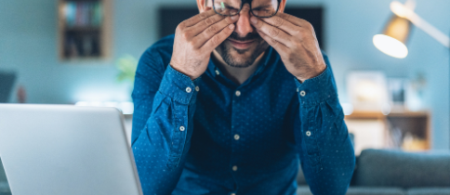
Impact on mental health

Slide 6
Anxiety/Depression

Slide 7
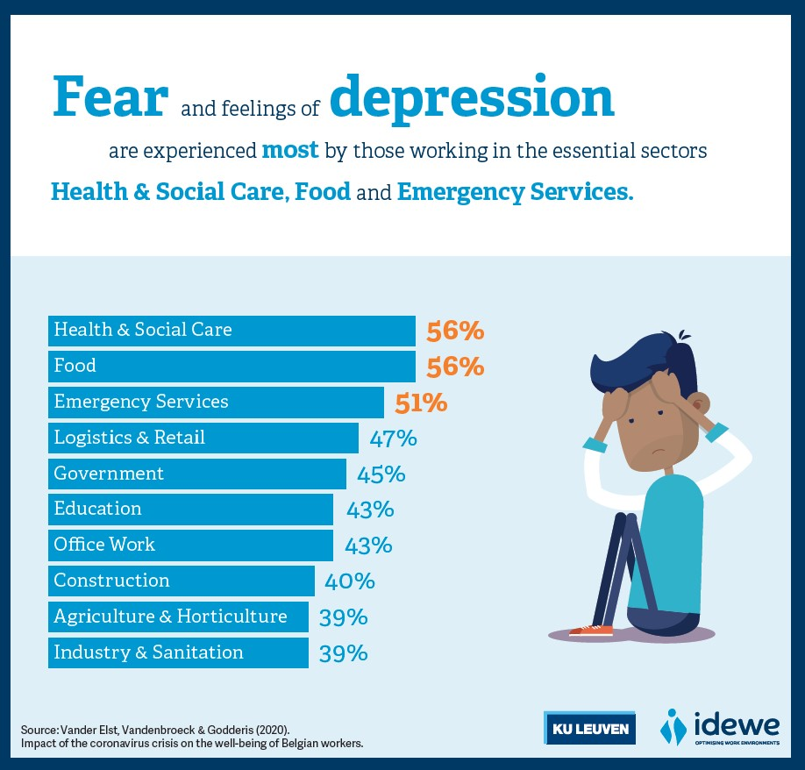

Slide 8
Social Dysfunction

Slide 9
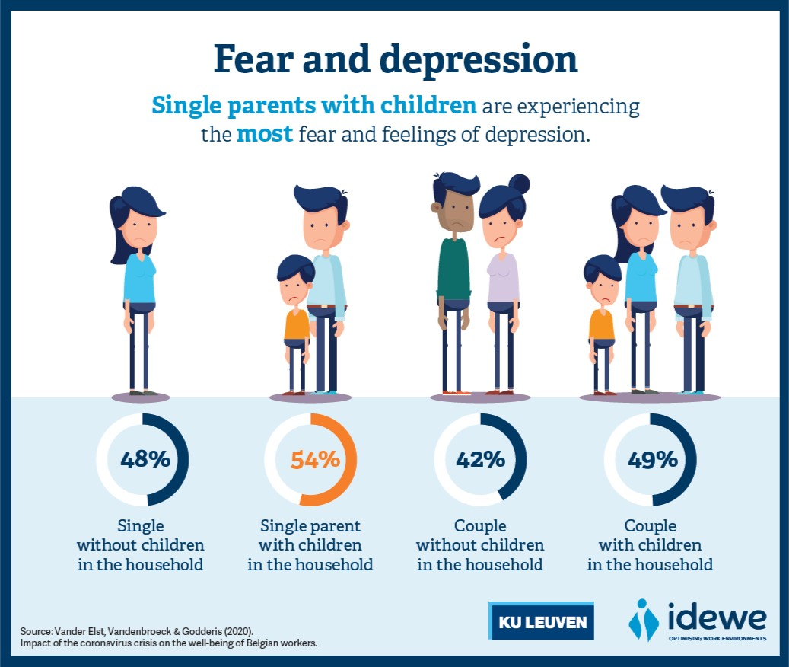

Slide 10
Work-Home

Slide 11
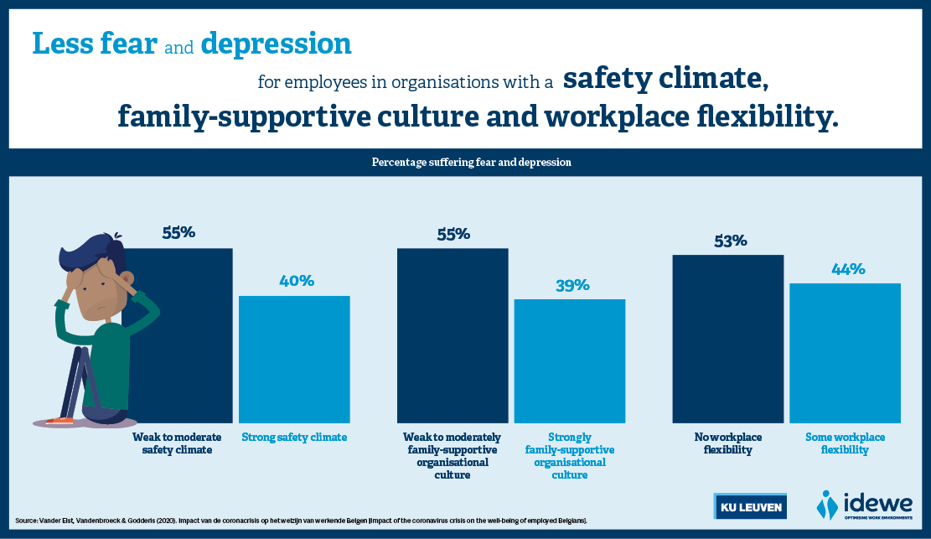

Slide 12
Impact on job resources

Slide 13
Impact on job resources

Slide 14
Impact on job resources

Slide 15
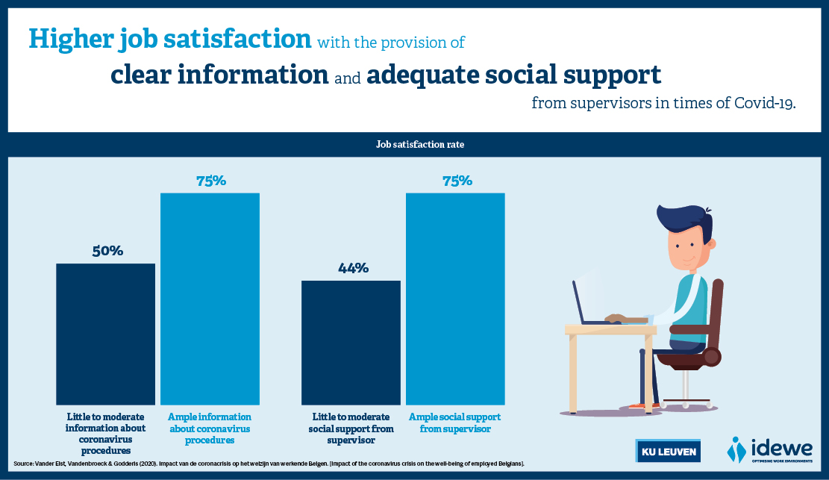

Slide 16
Impact on job resources

Slide 17
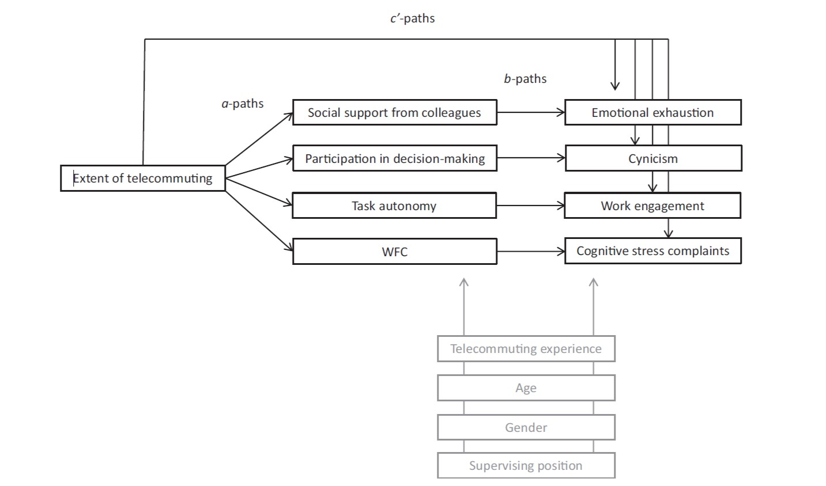


Vanderelst et al. 2017

Slide 18
Vanderelst et al. 2017

Slide 19
Vanderelst et al. 2017

Slide 20
Lessons learned: Five factors of Telework
Individual: personality + situation
Organisation: strategy + culture
Home + Family
Job: nature + technology
Environment: safety + legal
Belzunegui-Eraso and Erro-Garcés, 2020

Slide 21
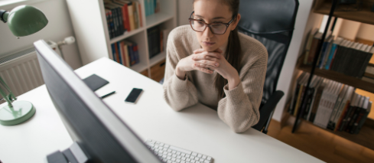
Impact on physical health

Slide 22

OptiDesk telework survey
New version of IDEWE*’s online self-assessment tool for the office worker, completely adapted to the needs of the telehomeworker
475 Belgian telecommuters
March until June, 2020 (Belgian’s first lockdown)
* Belgian external service for prevention and protection at work

Slide 23
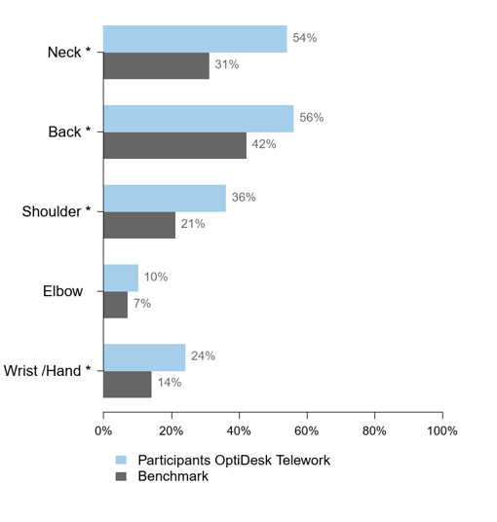
Musculoskeletal disorders
TELEWORK – The lower, the better
**
Daenen, Verwimp, Godderis, 2020
**representative group of 950 Belgian office workers
(weighted for gender, age, language and degree)

Slide 24
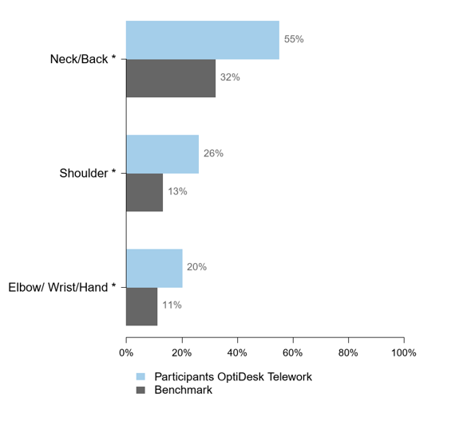
Musculoskeletal disorders
WORK-RELATED – The lower, the better
**
Daenen, Verwimp, Godderis, 2020
**representative group of 950 Belgian office workers
(weighted for gender, age, language and degree)

Slide 25
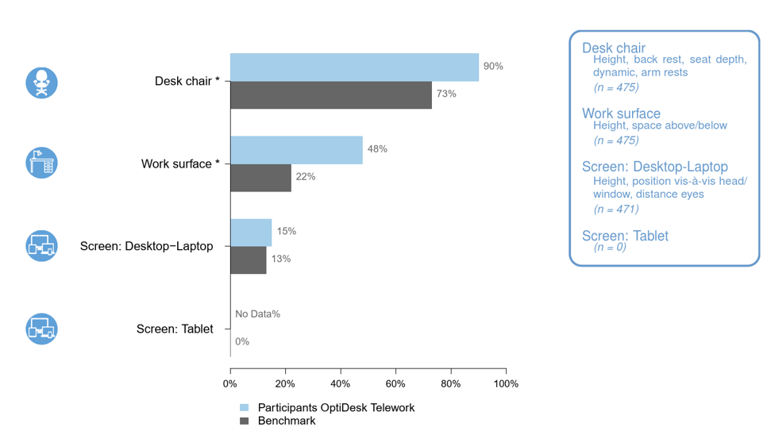
Ergonomics
TELEWORK – The lower, the better
**
**representative group of 950 Belgian office workers
(weighted for gender, age, language and degree)
Daenen, Verwimp, Godderis, 2020

Slide 26
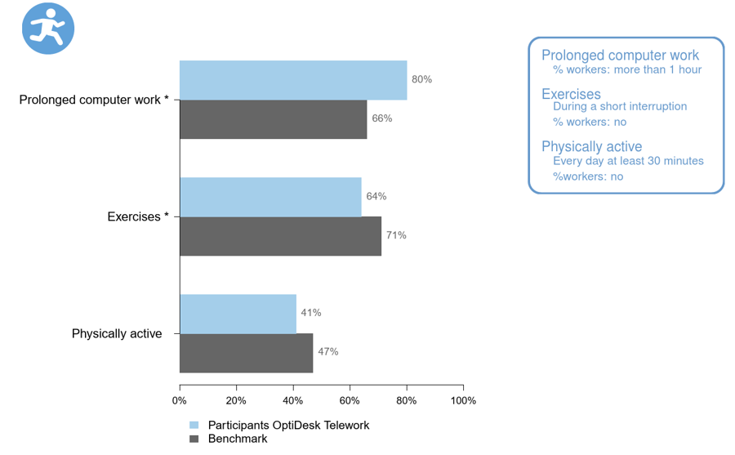
Movement
TELEWORK – The lower, the better
**
Daenen, Verwimp, Godderis, 2020
**representative group of 950 Belgian office workers
(weighted for gender, age, language and degree)

Slide 27
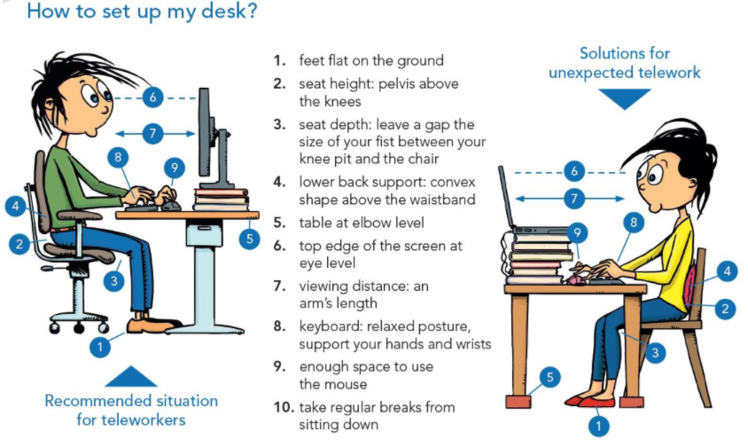
Lessons learned
Optimise workstation design and move
www.verv.be, november 2020

Slide 28
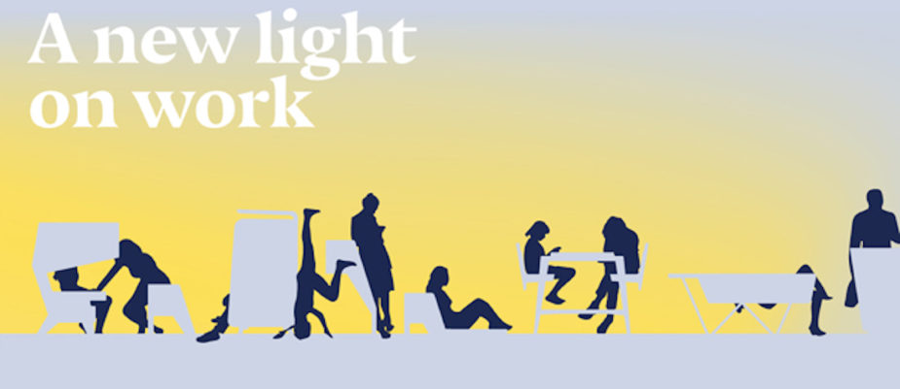
Lessons learned
From hybrid to activity-based / human-based working

Slide 29
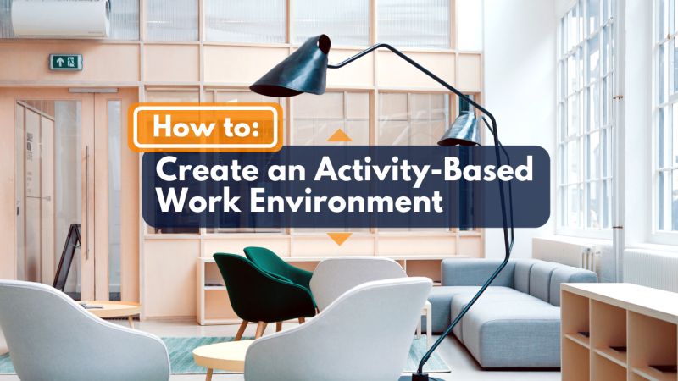
Lessons learned
Activity-based / human-based working

Slide 30
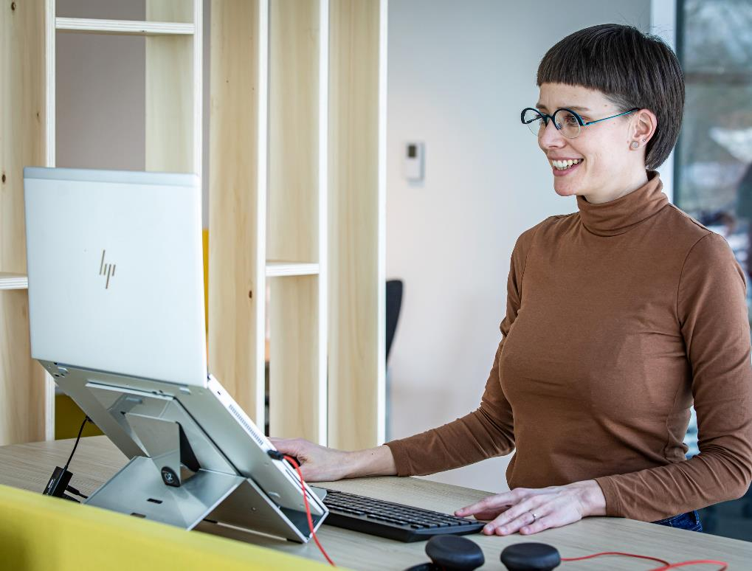
Lessons learned: bricks, bytes & behaviour
Future-proof post-corona workplace

Slide 31
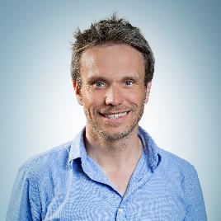
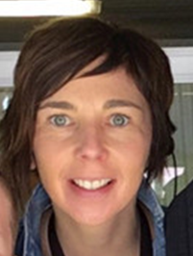
Contact
Frank
Functie
Frank@idewe.be
Anne-Marie
Functie
Anne-Marie@idewe.be
Lode Godderis
Liesbeth Daenen
CEO at IDEWE, professor occupational medicine at KU Leuven
Researcher at IDEWE, KU Leuven & Vrije Universiteit Brussel
Lode.godderis@idewe.be
Liesbeth.daenen@idewe.be

